Slide 1
Scrum Team 2 Product Release
Scrum Master :
Elgin Bowman
Development Team :
Scott Troutman, Adam Ingram, Johnny Hosler, Brandon Taylor, Pengzheng Yang, Zachary Alwine

Slide 2
Overview
ArgumentParser allows for the creation of different types of arguments and store data parsed from the command line.
Allows created arguments to be saved to and loaded from an XML file using the XMLManager class.
In-depth documentation found at add link here

Slide 3
Features
Positional Arguments
Holds a name, description, and data type
Can be restricted to a certain set of values
Throws exception if value provided doesn’t match data type
Throws exception if too few/many positional arguments are used

Slide 4
Features
Named Arguments
Inherits functionality from positional arguments
Stores a default value
Can be assigned and called by a pre-defined shorthand name
Can be set to be required
Can store multiple values
Can be assigned to a mutually exclusive group

Slide 5
Testing & Code Coverage
--% Pass rate on unit testing
--% Pass rate on acceptance testing
--% Code coverage

Slide 6
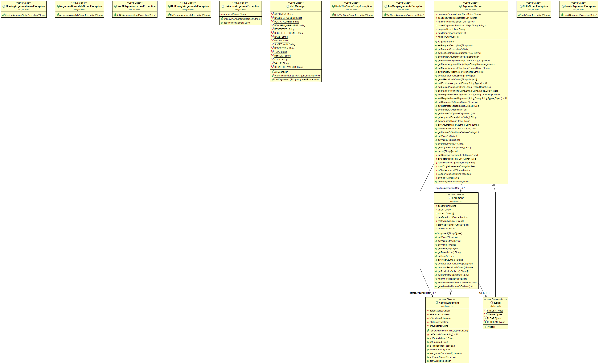
Class Diagram

Slide 7
Class Diagram
Part A.
Part C.
Part B.
Part D.

Slide 8
Class Diagram (Part A)

Slide 9
Class Diagram (Part B)

Slide 10
Class Diagram (Part C)

Slide 11
Class Diagram (Part D)

Slide 12
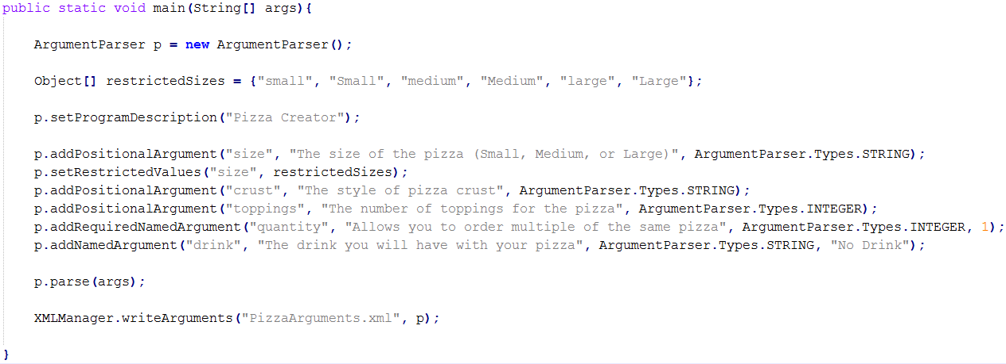
Writing Arguments

Slide 13
Running XML Write Demo
Ran with parameters:
Result: XML File

Slide 14
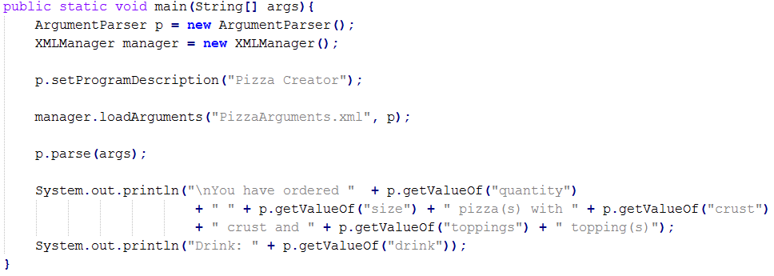
Loading Arguments

Slide 15
Running XML Load Demo
Ran with parameters:
Result:

Slide 16
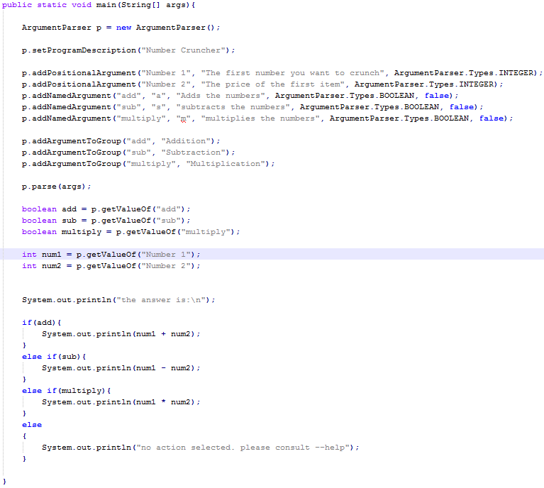
Mutually Exclusive Demo Using Shorthand Arguments

Slide 17


Running the Addition Demo
Ran with parameters:
Result:

Slide 18


Running the Subtraction Demo
Ran with parameters:
Result:

Slide 19

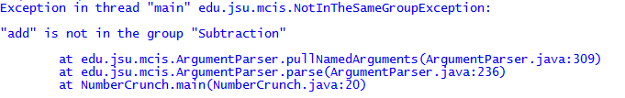
Failing Mutual Exclusion
Trying to run previous demo with parameters:
Result

Slide 20
Agile Estimating and Planning Technique
Story Points
Planning Poker
1 = easy
2 = fairly easy
3 = moderate
5 = fairly difficult
8 = difficult
Total of 78 story points

Slide 21
Burndown Chart

Slide 22
SCRUM Stuff

Slide 23

Thank You For Your Time

